Slide 1
Making Water YOUR Business (Water and Wastewater Services)
Presentation Summary
Presented by: Shaun Johnston Date of presentation: 15 September 2022

Slide 2
Background

Slide 3
Objectives for managing a local water utility
Local water utilities, with the support of QLD Government agencies and regulators, will continue to ensure:
Safe and secure water supply to protect public health and the environment, and to support economic development and liveability.
Effective sewerage services to protect public health and the environment, and to support economic development and liveability.
Services that meet customer needs, expectations and preferences.
Financially sustainable water utilities with efficient and affordable pricing for services.

Slide 4
Water service provision is different to other council activities
Local water utilities have intrinsic public health, environmental health and supply risks that need to be managed.
Water services support economic growth, liveability and amenity for our communities. During the last drought many communities were confronted with the real possibility of running out of water and had to make tough decisions on restricting consumption.
Water is an essential service that needs to be up and running 24 hours per day, 7 days per week. This includes drinking water, sewerage services and recycled water.
Unlike other council infrastructure such as a town hall or library, water and sewerage infrastructure is usually out of sight, underground or far from town.
Under business as usual, your community expect water to flow when they turn on the tap and they expect their waste to just disappear when they flush their toilet. It is often only when things don’t look or smell right, when restrictions are imposed or when prices go up that you will hear from your community.

Slide 5
Your decisions count

Slide 6
As a Councillor you be called upon to make important and complex decisions on:
Pricing of water supply and sewerage services
Setting service levels in consultation with your community
Budgeting for the operation and maintenance of current water and sewerage services
Ensuring sufficient money is allocated to human resources for the staffing, skills, safety and training of your water business
Planning and budgeting for future water needs, including taking into account the future needs of your community and climate change
Efficient and prudent investment for water and sewerage services
Ensuring continued water and sewerage services during extreme events such as floods, bushfires and droughts
Issuing a boil water alert
Implementing water restrictions
Keeping the community informed about water and sewage matters, including during water restrictions, boiled water alerts or other incidents.

Slide 7
Challenges facing regional water utilities
There are numerous challenges currently facing local water utilities:
Climate variability and the need for resilient water supplies
Scale and ability to attract and retain skilled and specialist staff
Competing demands for attention in a local government environment, affecting the ability to focus on effective planning, investment and service delivery for water services
Continued protection of public and environmental health
Financial sustainability of water utilities serving small populations with large and particularly ageing asset bases
Planning, funding and project managing water and sewerage projects
Declining water and sewerage asset condition.
Ideally, good strategic planning combined with transparent and informed decision-making will ensure a proactive response to these challenges.

Slide 8
Why do we treat water?

Slide 9
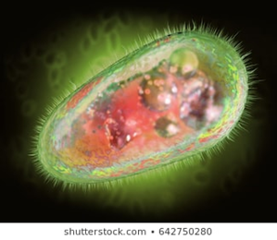
Pathogens
Pathogen: a microorganism that can cause disease:
Virus
Hepatitis, Rotavirus, Coronavirus, etc.
Bacteria
E. coli, Salmonella, Cholera, etc.
Protozoa
Giardia, cryptosporidium, Entamoeba, etc.
Fungi and Worms not usually a first world issue in water supplies.

Slide 10
Australian Drinking Water Guidelines (ADWG)
The microbial guidelines seek to ensure that drinking water is free of microorganisms that can cause disease. The provision of a safe drinking water supply is of paramount importance to the health of a community.
The most common and widespread health risk associated with drinking water is contamination, either directly or indirectly, by human or animal excreta and the microorganisms contained in faeces.
The classic waterborne diseases are caused by organisms originating in the gut of humans or other animals. However, many organisms of environmental origin that are not normally associated with the gastrointestinal system are found in water, and some of these organisms may, under certain circumstances, cause disease in humans.
Outbreaks of waterborne disease are frequently characterised by infection across a whole community.

Slide 11
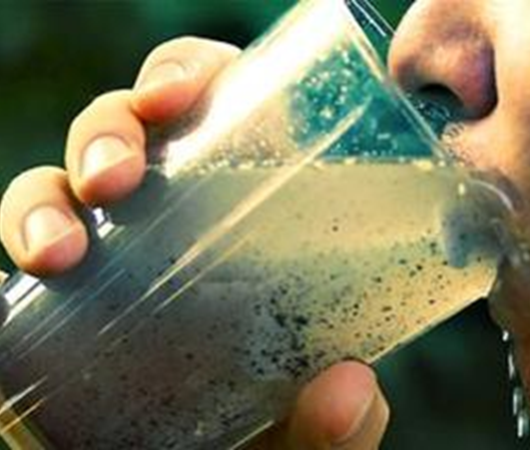
Chemical contaminants
Everything other than H2O:
Chlorine, fluoride, alum and other treatment chemicals,
Minerals and salts from the soil and soil surfaces,
Organic matter from plants and animals,
Elements from the atmosphere,
Fertilisers,
Pesticides, fungicides and herbicides,
Hormones, and growth promotants,
Personal Care Products (PCPs),
General pollution, including micro and nano plastics.
Emerging contaminants (like PFAS).

Slide 12
How do we treat pathogens and contaminants?

Slide 13
ADWG - 12 Elements
Commitment to drinking water quality management (policies, regulation and engagement).
Assessment of the drinking water system (data collection, analysis and risk assessments).
Preventive measures for drinking water quality management ( Critical Control Points, catchment assessments/management and presence of multiple barriers).
Operational procedures and process control (procedures, monitoring, corrective action, maintenance, equipment and materials ).
Verification of drinking water quality (DWQMP/CSS: quality monitoring, consumer satisfaction, assessment and corrective action).
Management of incidents and emergencies (communications, response and business continuity).
Research and development (investigation, research, design).
Employee awareness and training (employee certification and training).
Community involvement and awareness (communication and consultation).
Documentation and reporting (document control, information management and reporting protocols).
Evaluation and Audit (Evaluate long-term results and audit of DWQMP implementation).
Review and continual improvement (Review by executive and DWQMP improvement plan).

Slide 15
QUESTION TIME

