Slide 1
Queensland’s Urban Potable Water and Sewerage Benchmarking: 2019/20
Small and Indigenous service providers
Sewerage Services

Slide 2
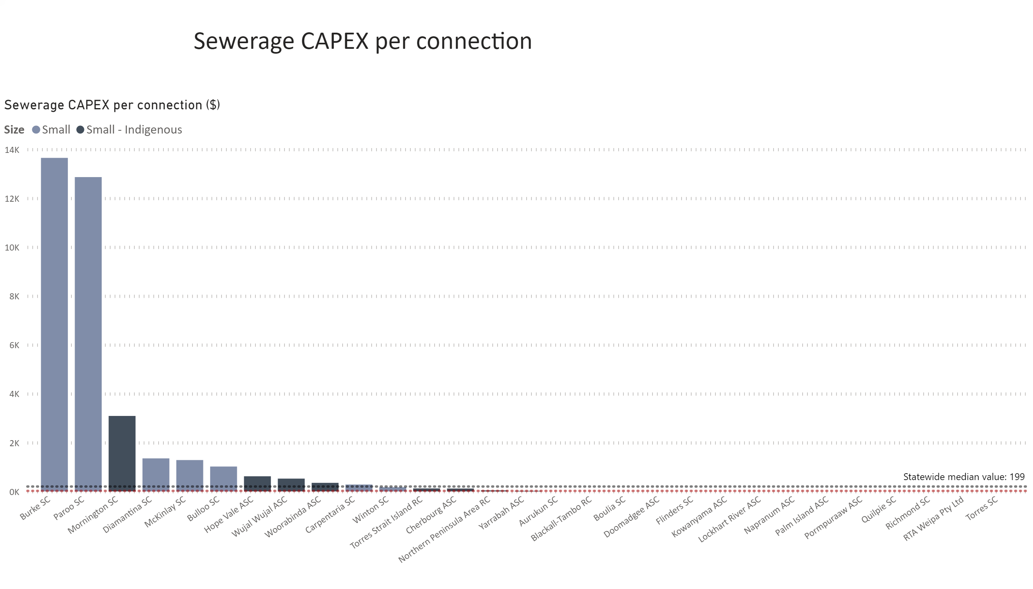
Sewerage CAPEX pp
Notes:
Sewerage CAPEX per connection ($)
No alt text provided.
textbox
No alt text provided.

Slide 3
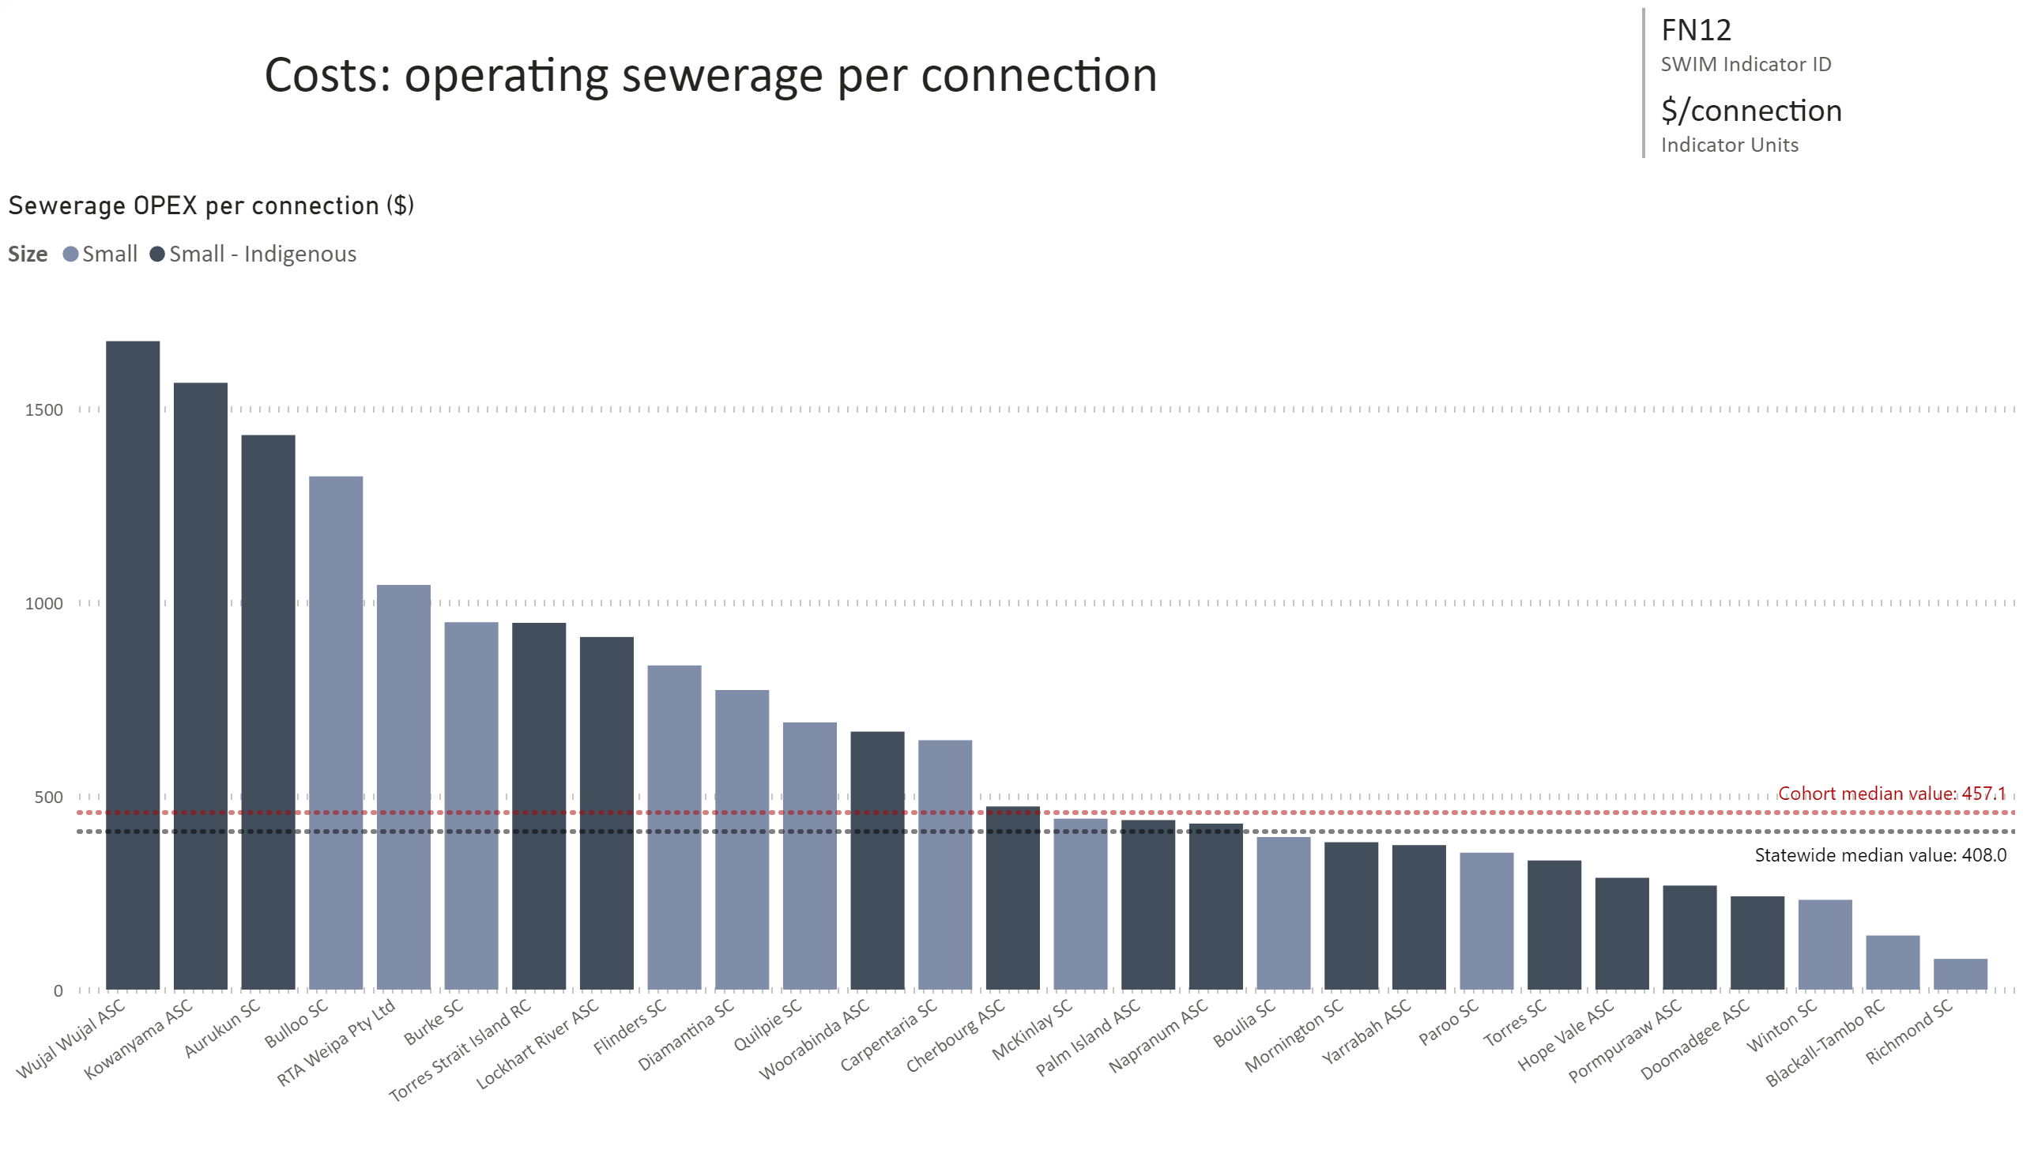
FN12
Notes:
Sewerage OPEX per connection ($)
No alt text provided.
card
No alt text provided.
multiRowCard
No alt text provided.

Slide 4
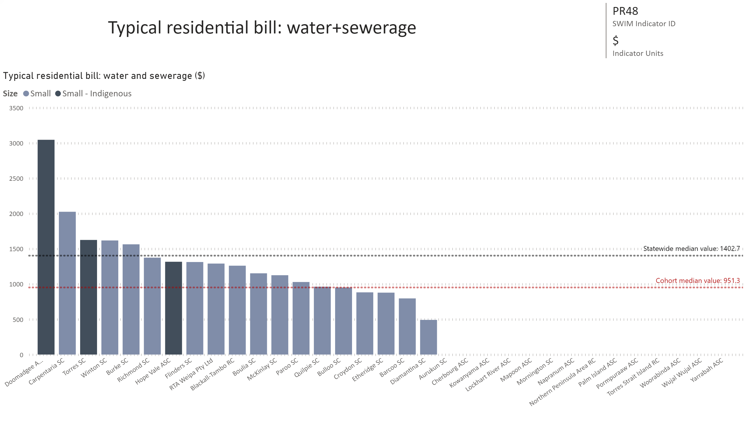
PR48
Notes:
Typical residential bill: water and sewerage ($)
No alt text provided.
card
No alt text provided.
multiRowCard
No alt text provided.

Slide 5
ERRR sewerage
Notes:
Economic Real Rate of Return: sewerage
No alt text provided.
textbox
No alt text provided.

Slide 6
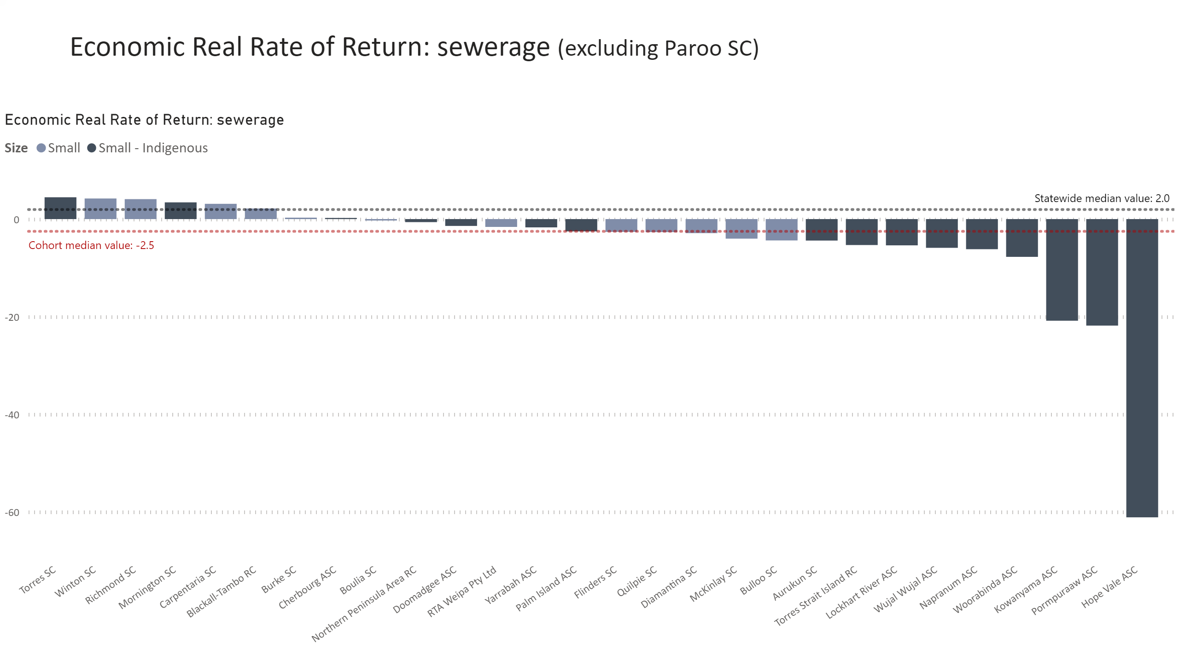
Duplicate of ERRR sewerage
Notes:
Economic Real Rate of Return: sewerage
No alt text provided.
textbox
No alt text provided.

Slide 7
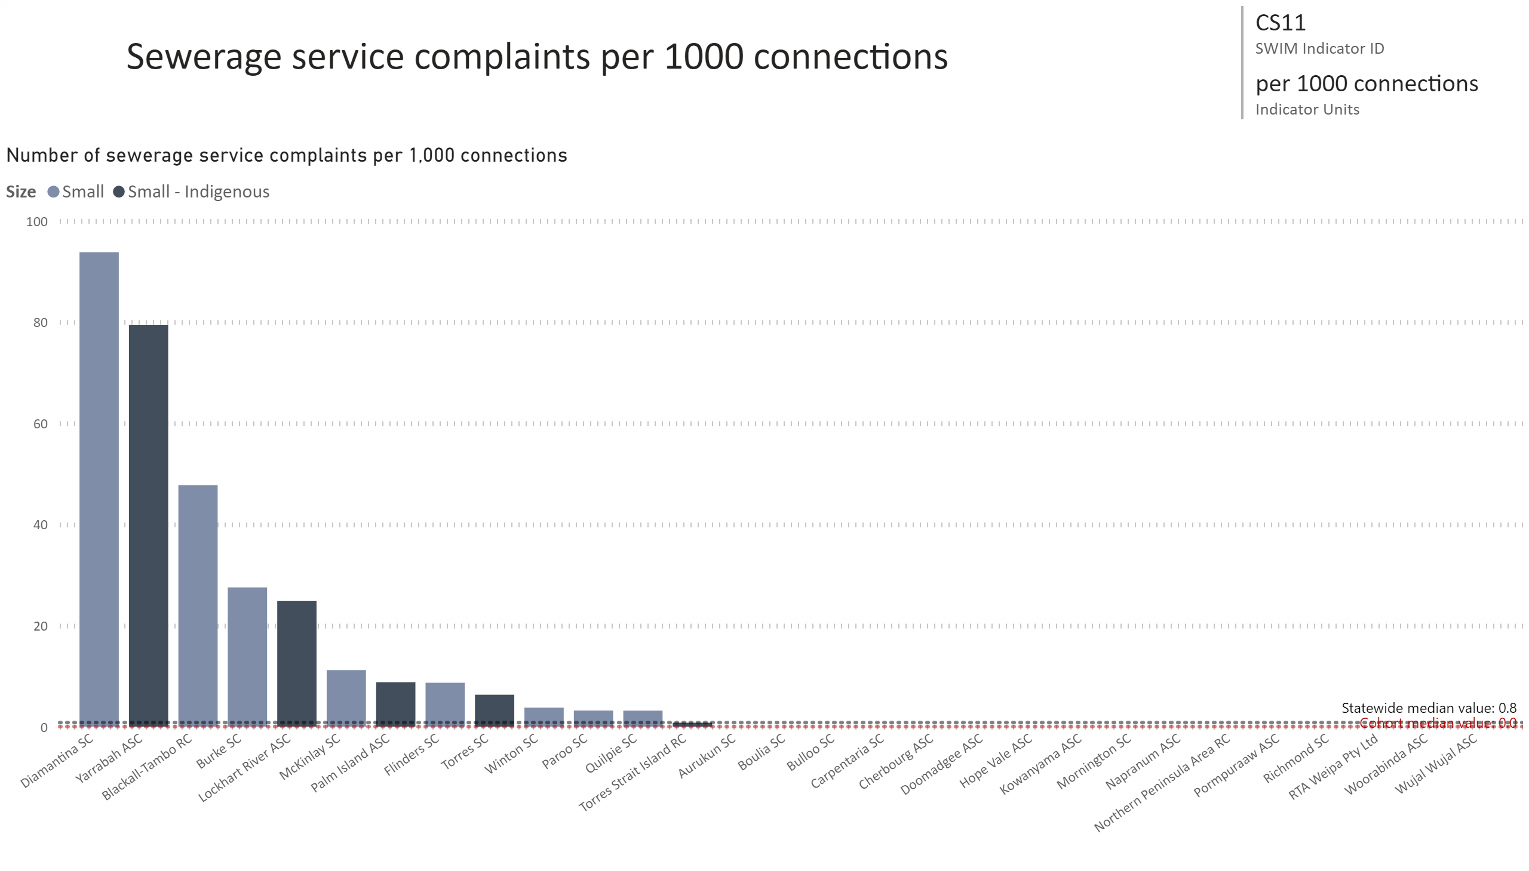
CS11
Notes:
Number of sewerage service complaints per 1,000 connections
No alt text provided.
card
No alt text provided.
multiRowCard
No alt text provided.

Slide 8
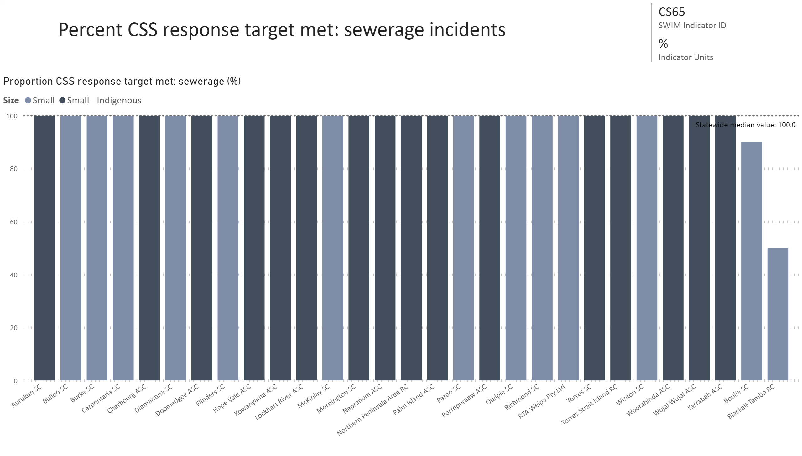
CS65
Notes:
Proportion CSS response target met: sewerage (%)
No alt text provided.
card
No alt text provided.
multiRowCard
No alt text provided.

Slide 9
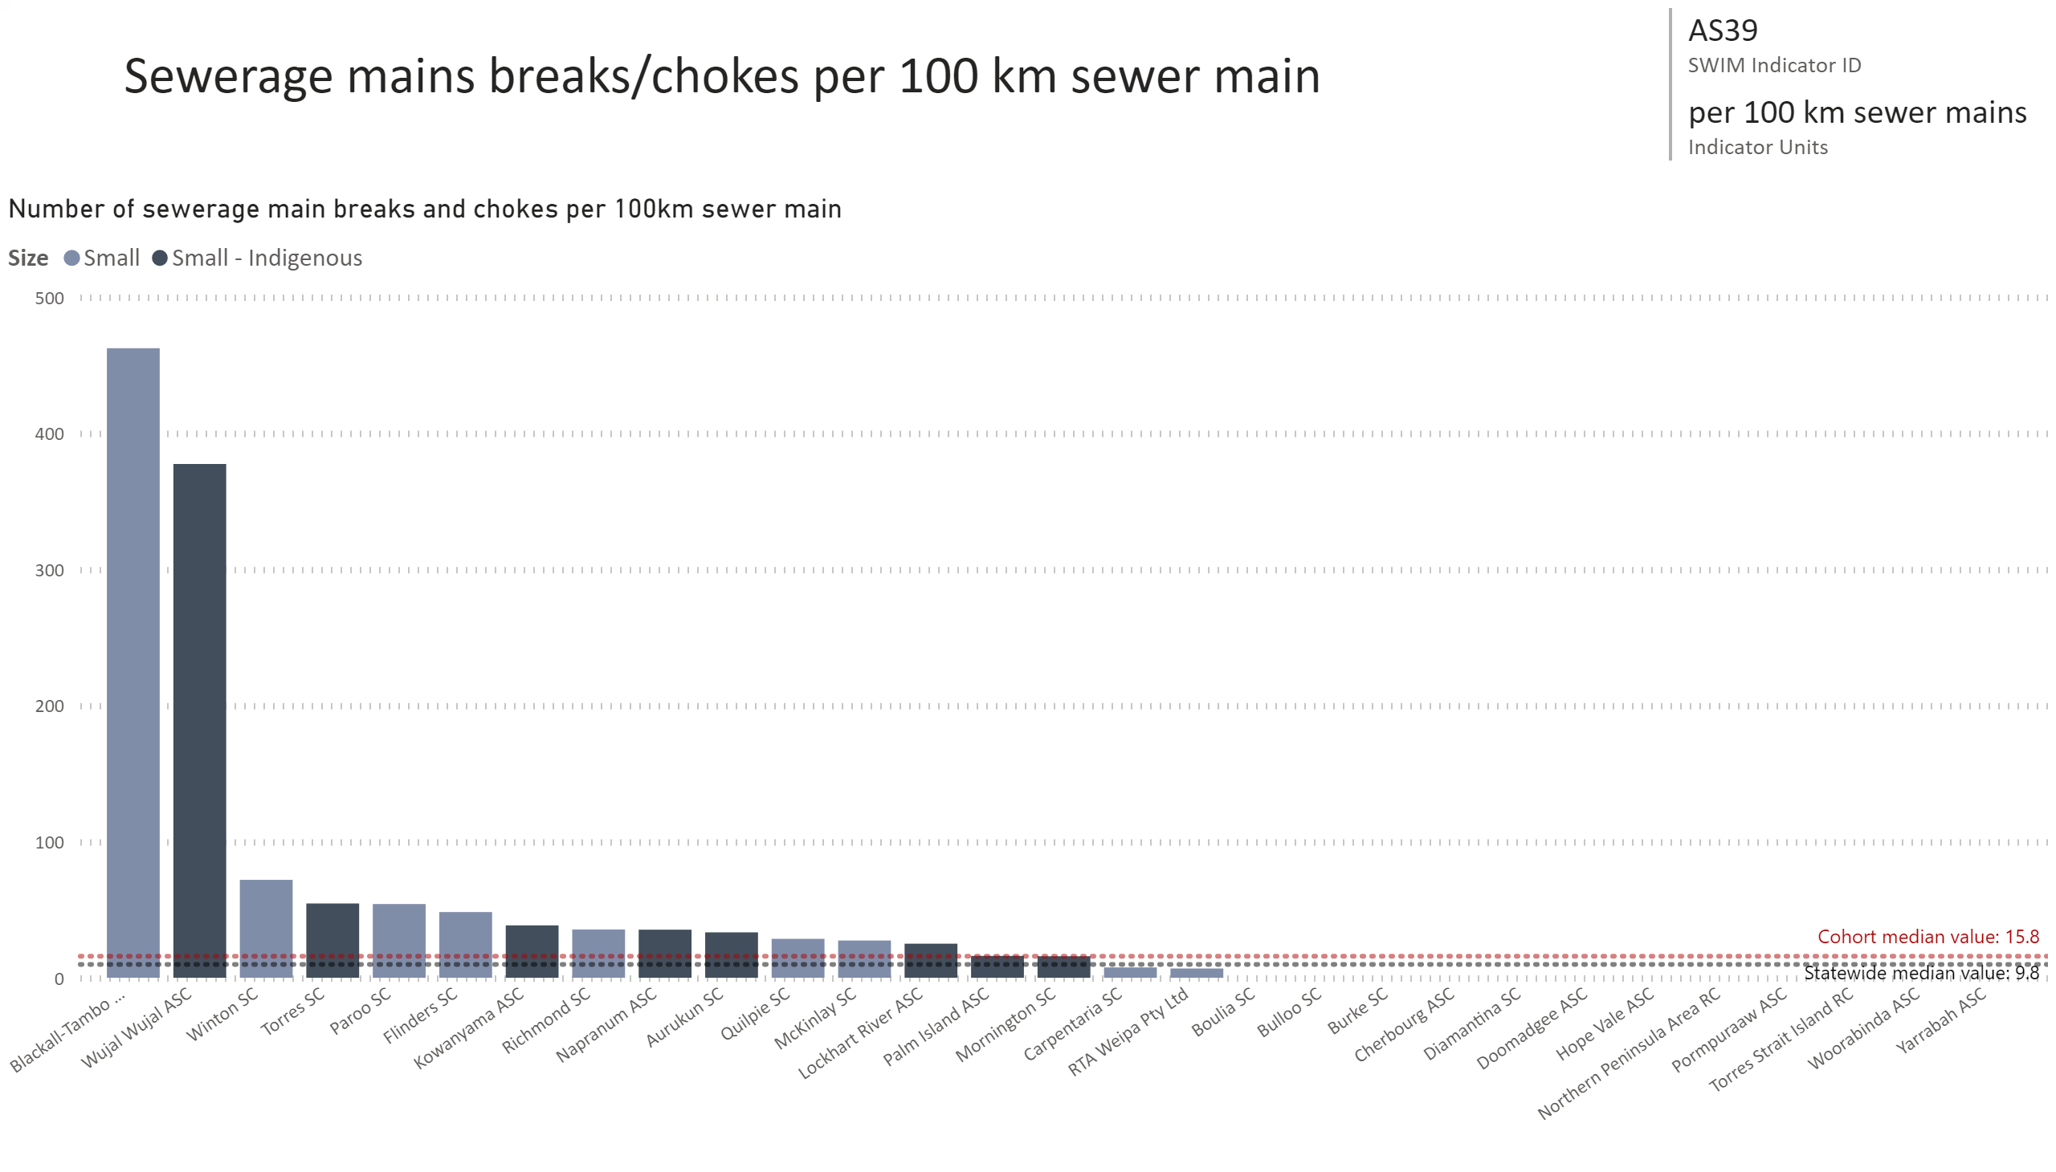
AS39
Notes:
Number of sewerage main breaks and chokes per 100km sewer main
No alt text provided.
card
No alt text provided.
multiRowCard
No alt text provided.

Slide 10
Small and Indigenous service providers
Potable Water Supply

Slide 11
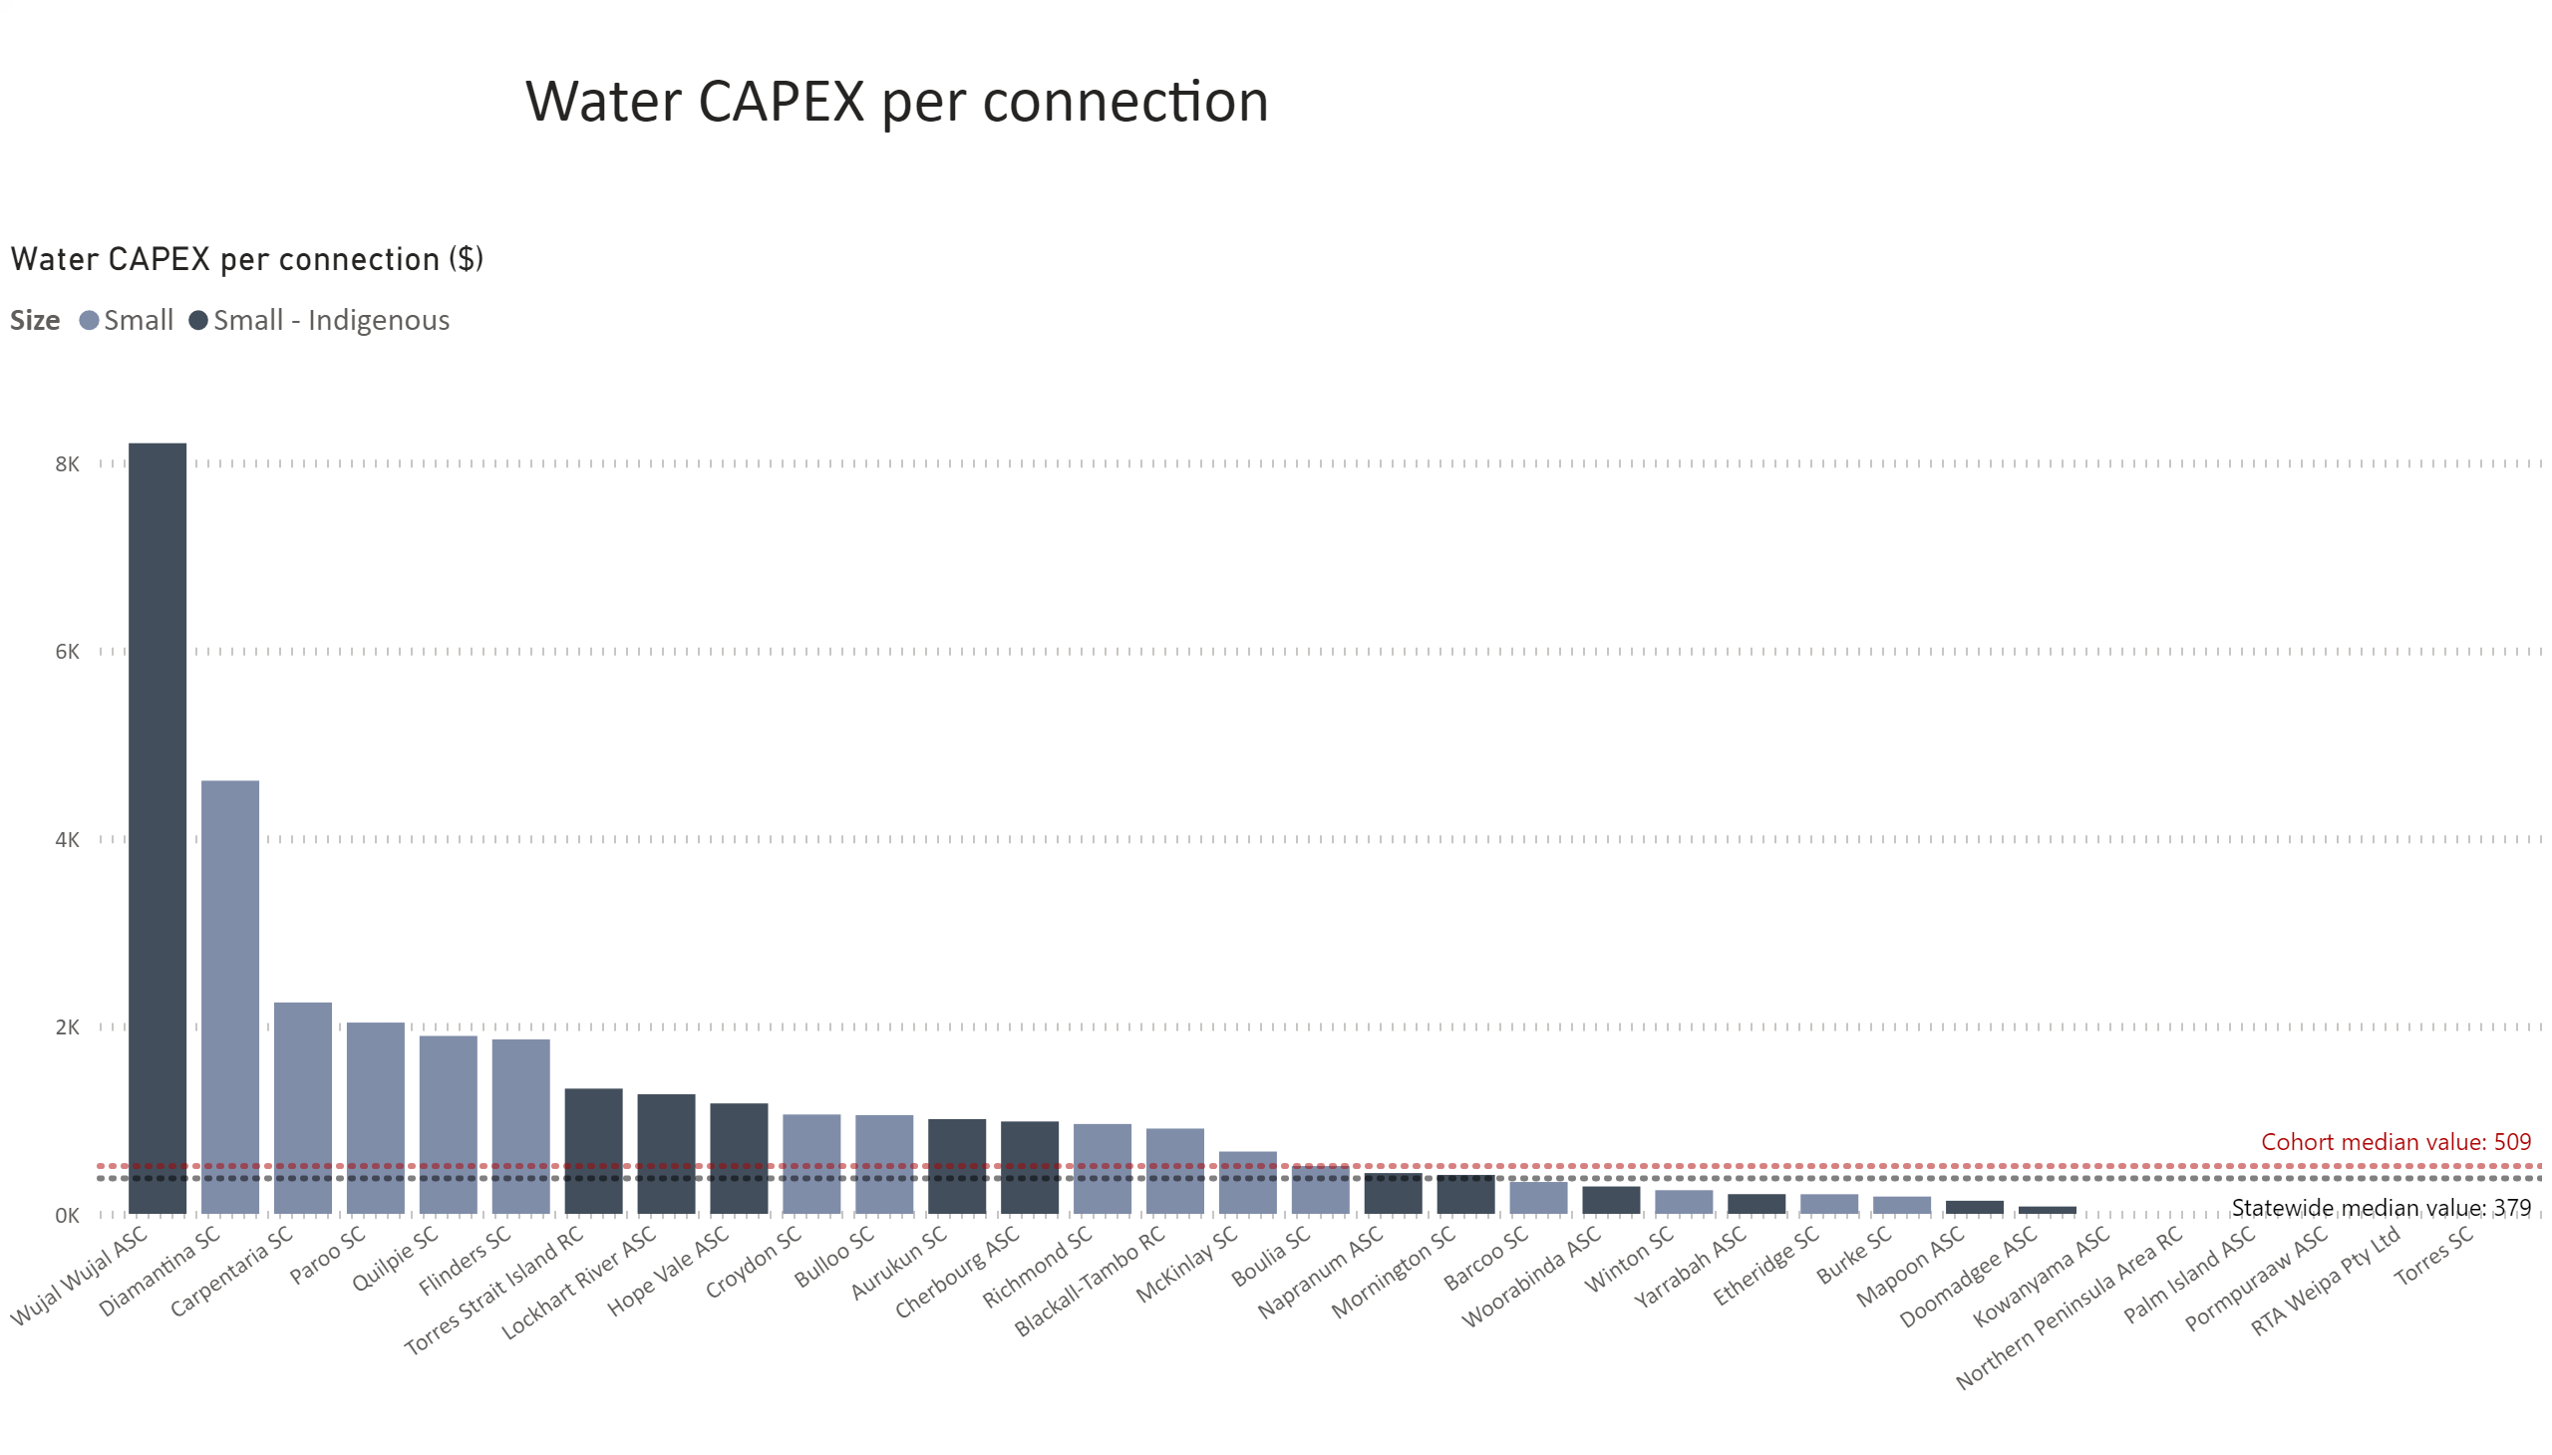
Water CAPEX pp
Notes:
Water CAPEX per connection ($)
No alt text provided.
textbox
No alt text provided.

Slide 12
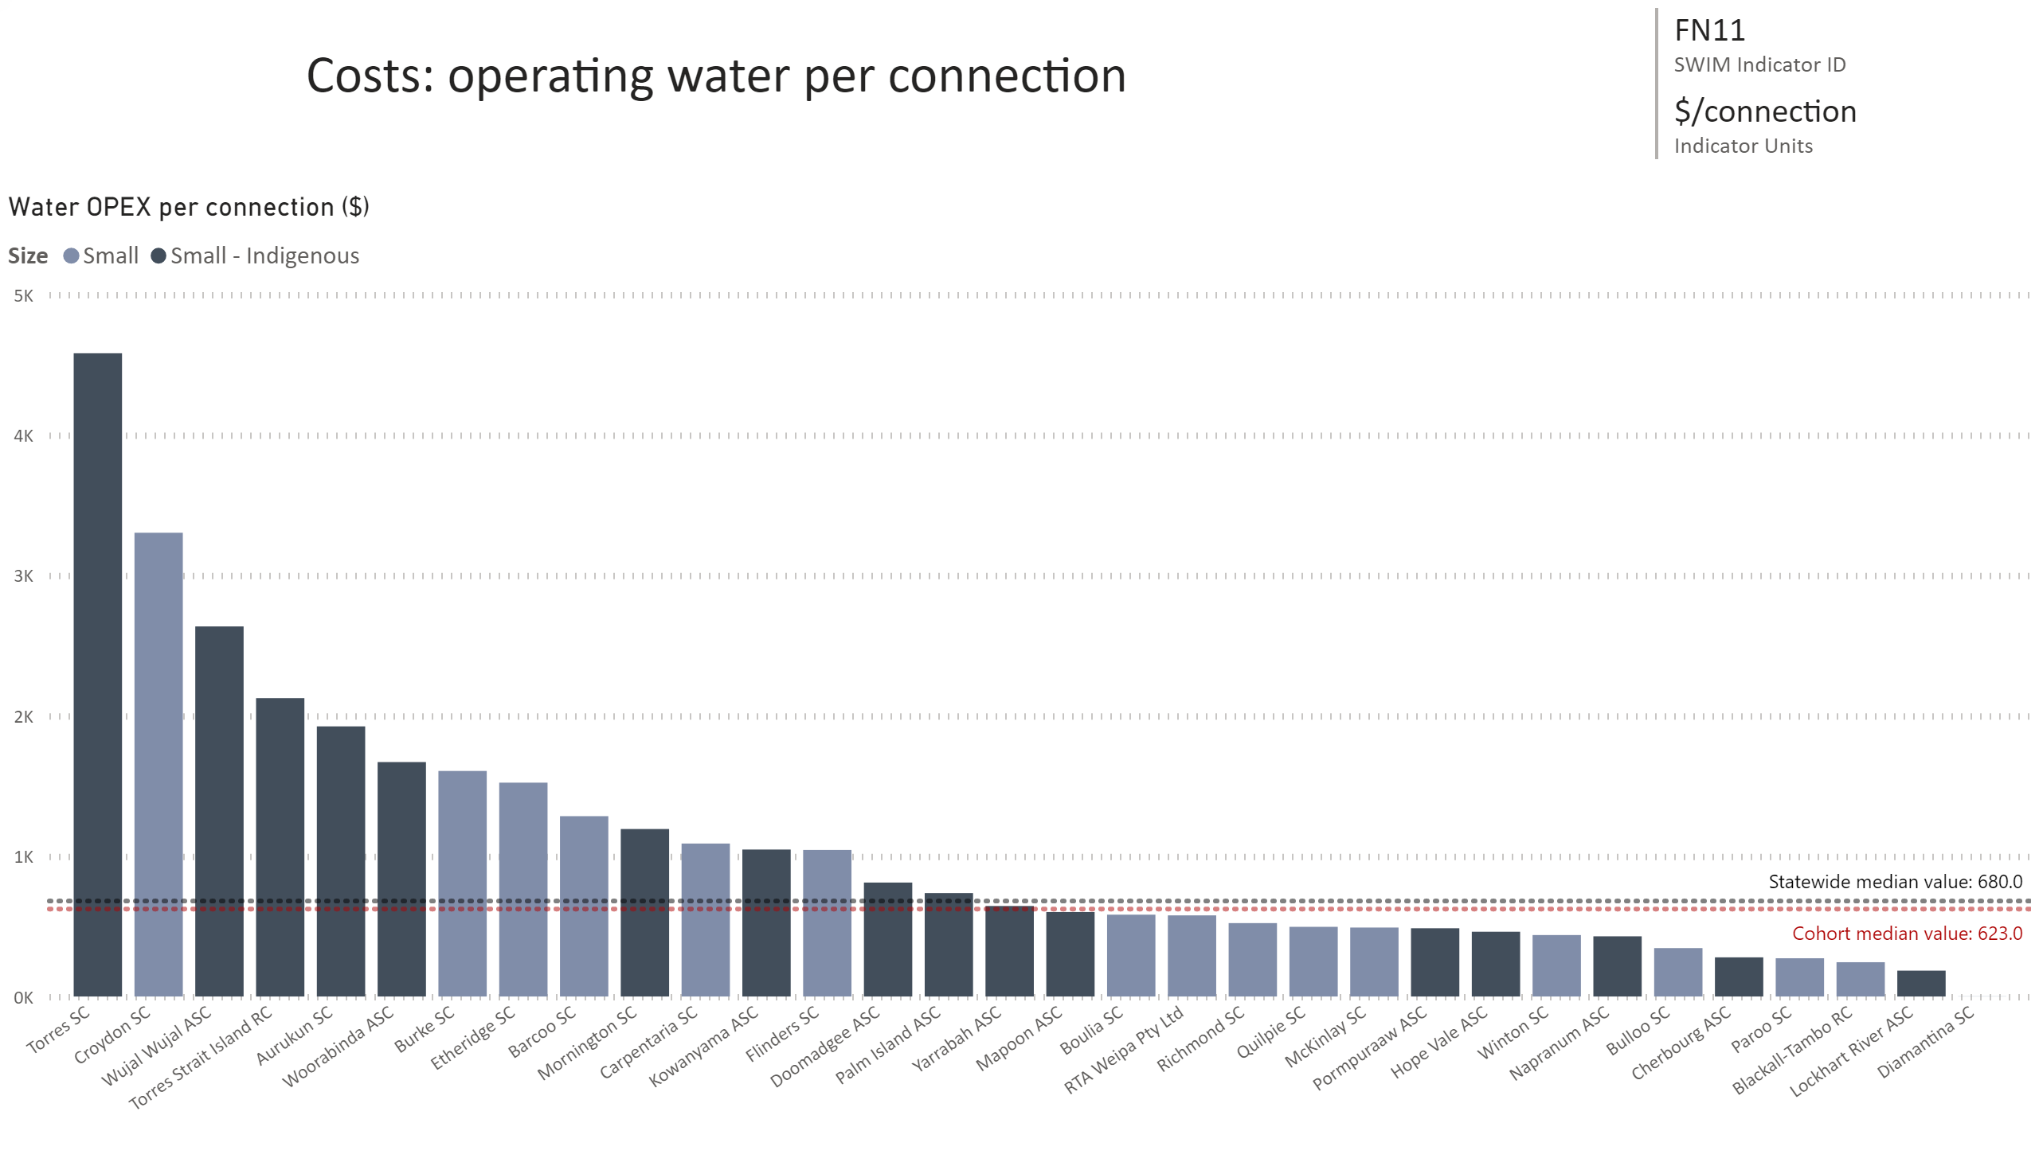
FN11
Notes:
Water OPEX per connection ($)
No alt text provided.
card
No alt text provided.
multiRowCard
No alt text provided.

Slide 13
ERRR water
Notes:
Economic Real Rate of Return: water
No alt text provided.
textbox
No alt text provided.

Slide 14
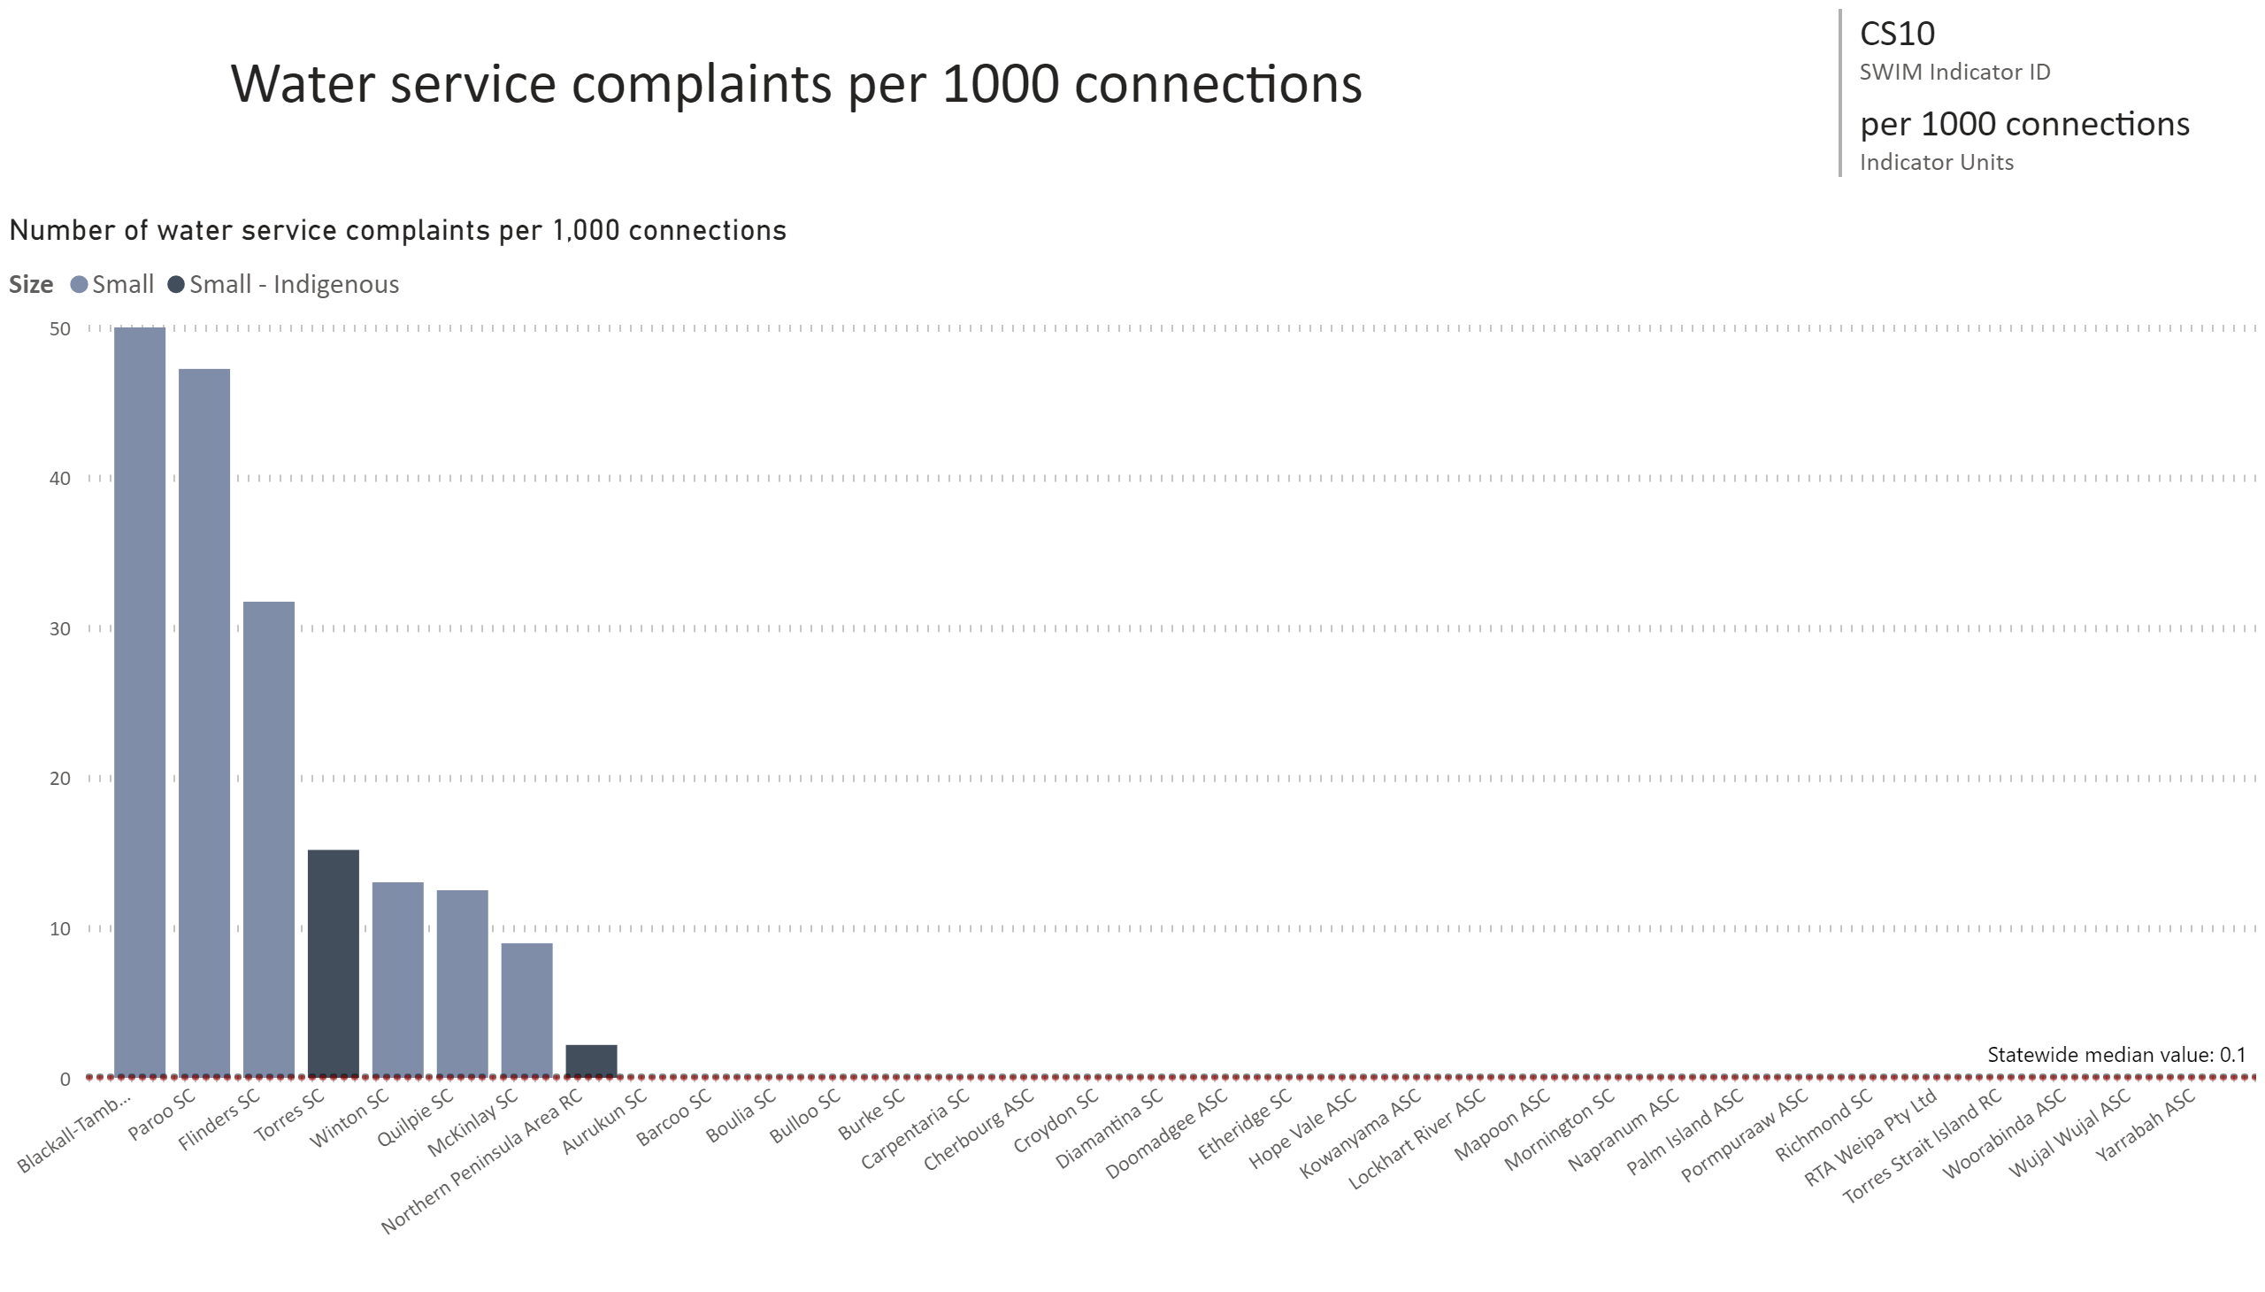
CS10
Notes:
Number of water service complaints per 1,000 connections
No alt text provided.
card
No alt text provided.
multiRowCard
No alt text provided.

Slide 15
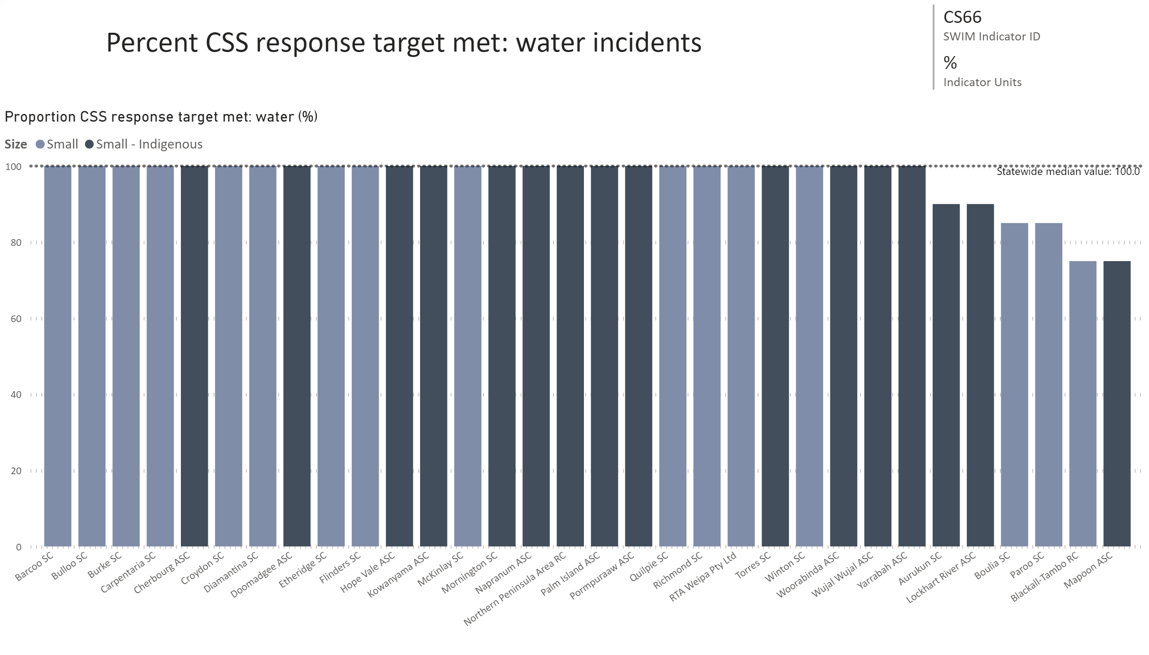
CS66
Notes:
Proportion CSS response target met: water (%)
No alt text provided.
card
No alt text provided.
multiRowCard
No alt text provided.

Slide 16
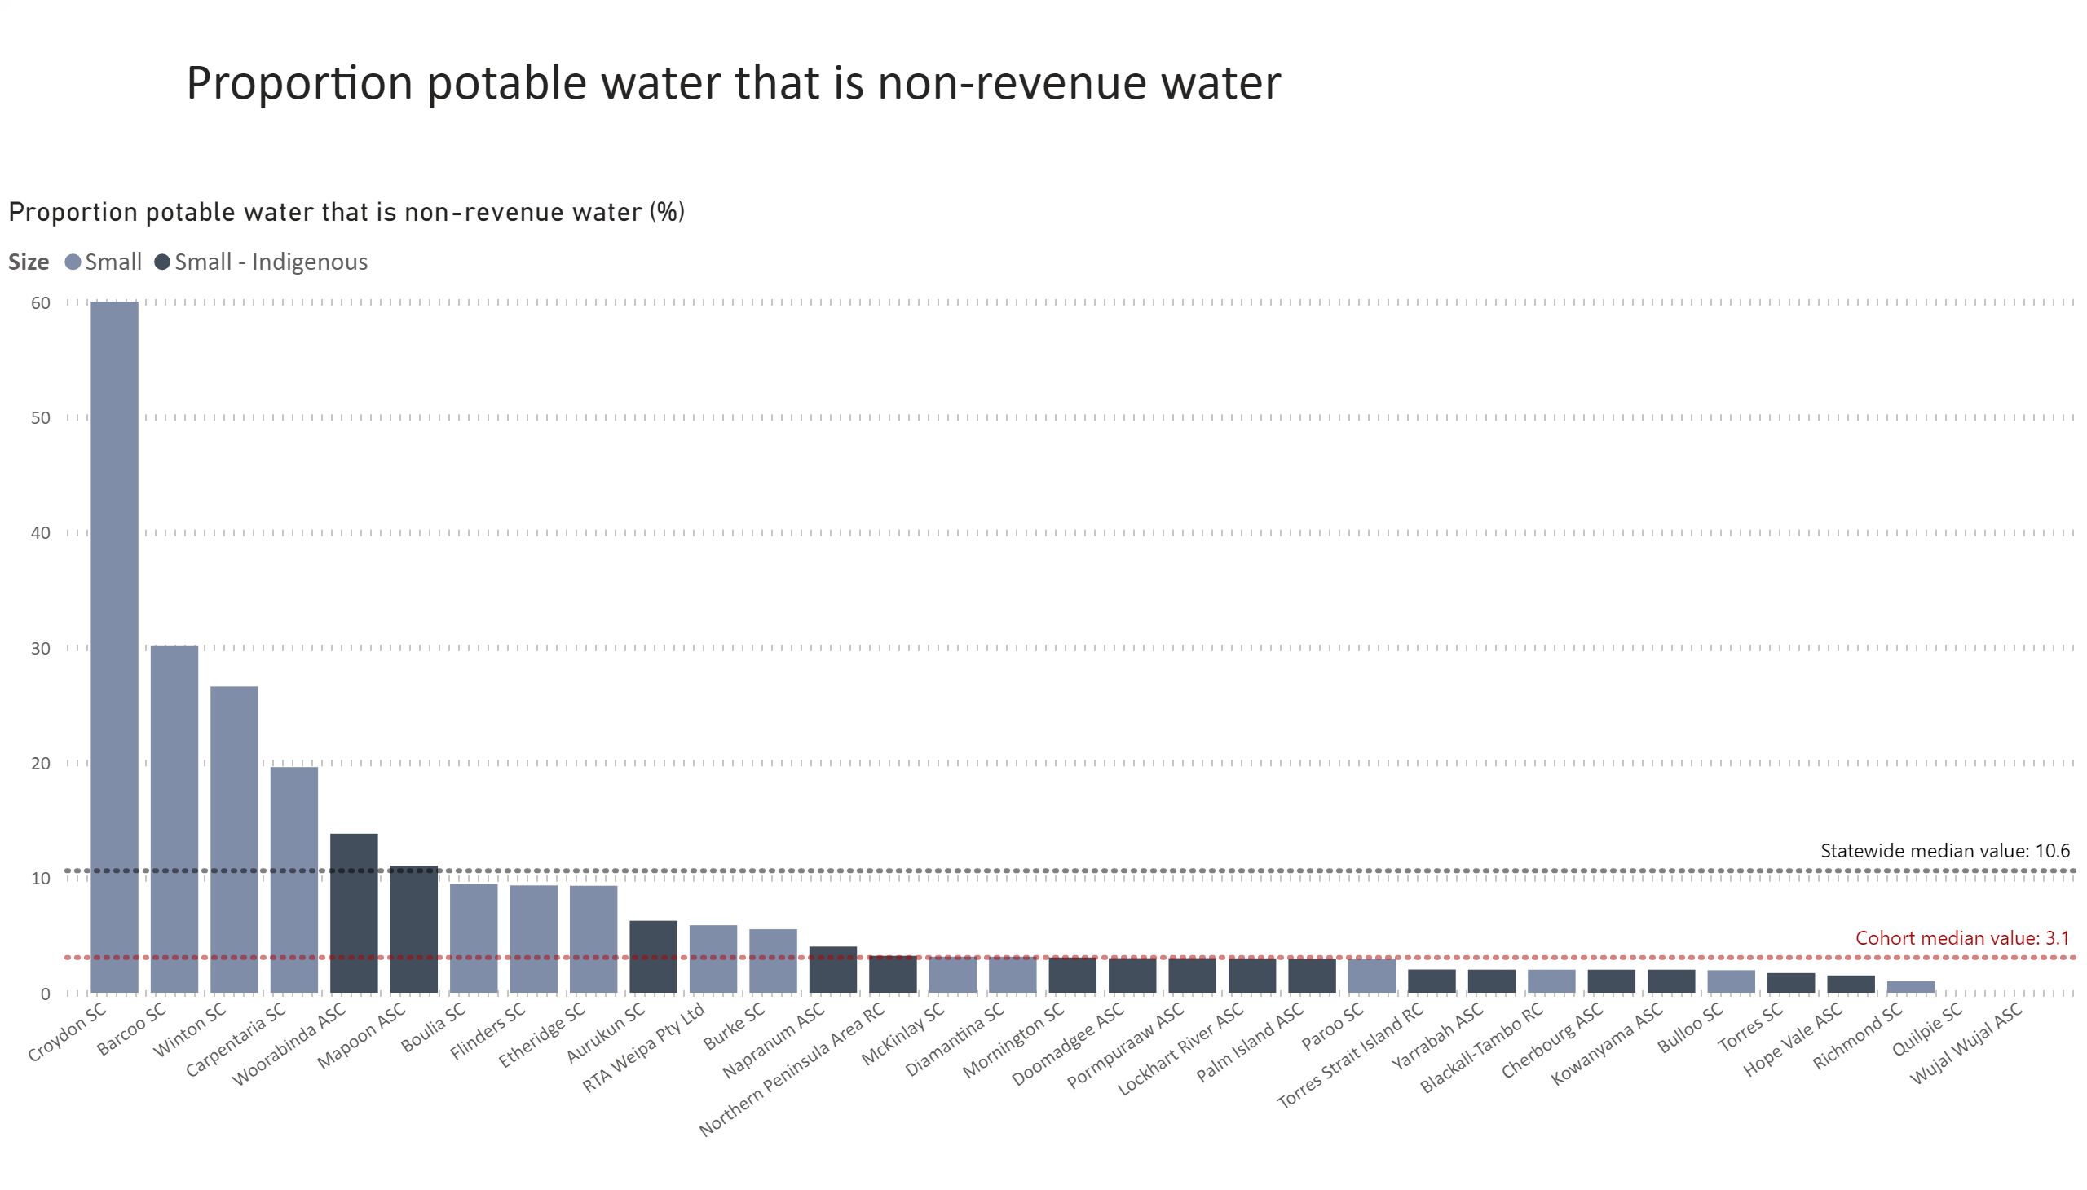
Prop NRW
Notes:
Proportion potable water that is non-revenue water (%)
No alt text provided.
textbox
No alt text provided.

Slide 17
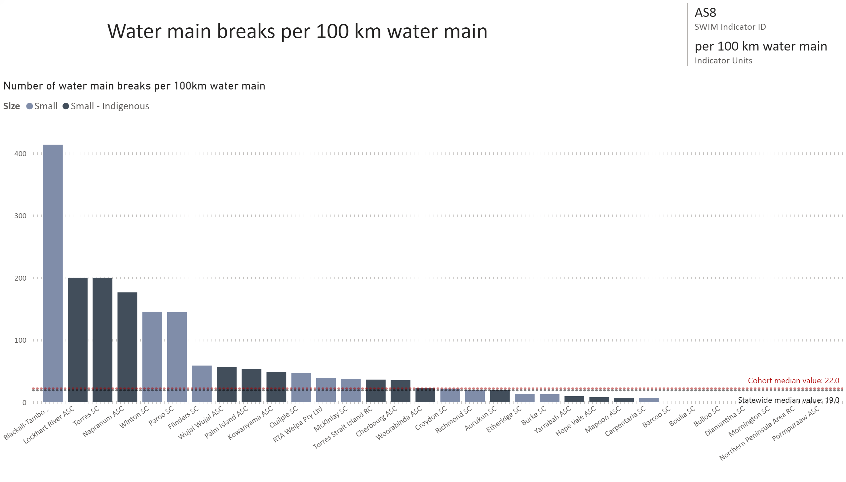
AS8
Notes:
Number of water main breaks per 100km water main
No alt text provided.
card
No alt text provided.
multiRowCard
No alt text provided.

Slide 18
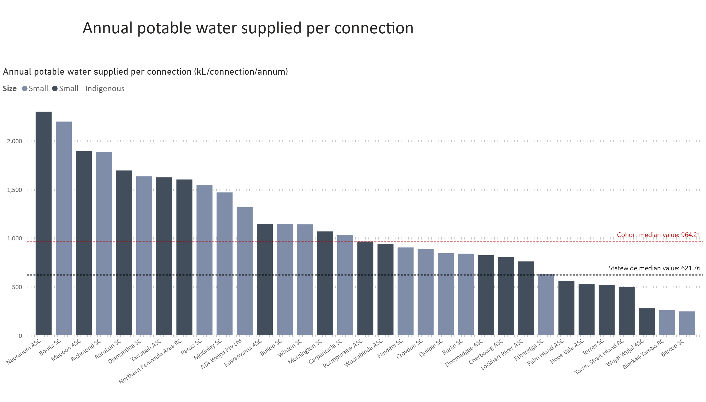
WA30 equivalent
Notes:
textbox
No alt text provided.
Annual potable water supplied per connection (kL/connection/annum)
No alt text provided.

Slide 19
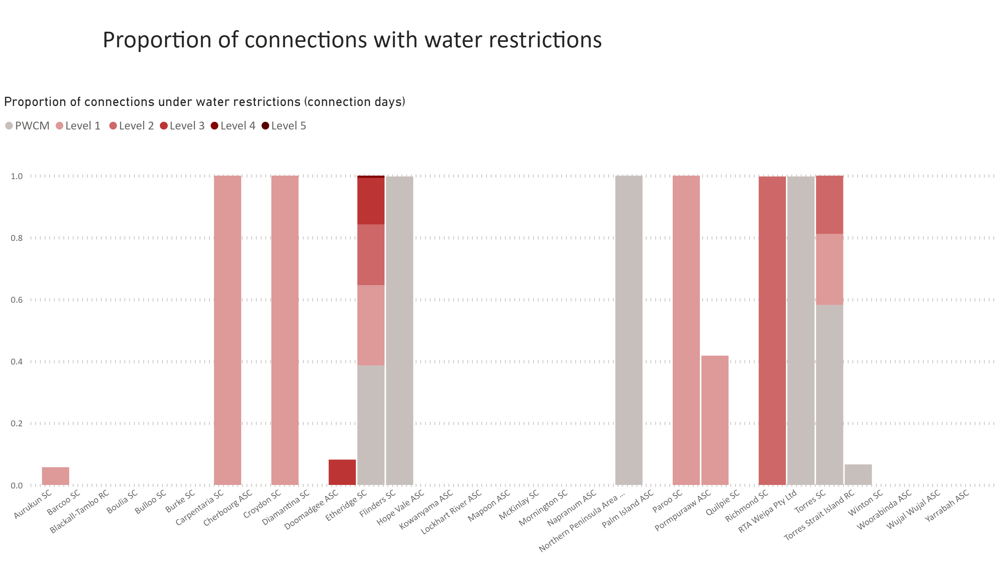
Water security SIND
Notes:
Proportion of connections under water restrictions (connection days)
No alt text provided.
textbox
No alt text provided.

